Slide 1
Reading Data

Slide 2
Reading Data
Data lezen via DBContext
Lambda syntax
ViewData ⬄ View Model
@model IEnumerable<MvcMovie.Models.Movie>
@model MvcMovie.Models.Movie
DataAnnotations

Slide 3
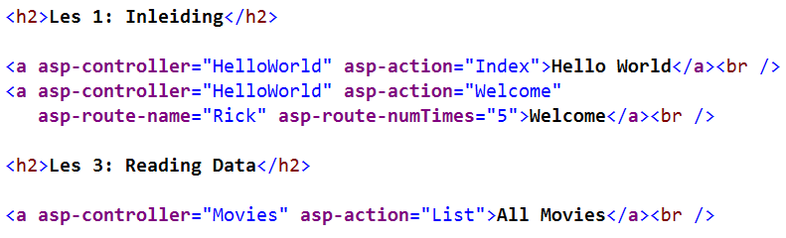
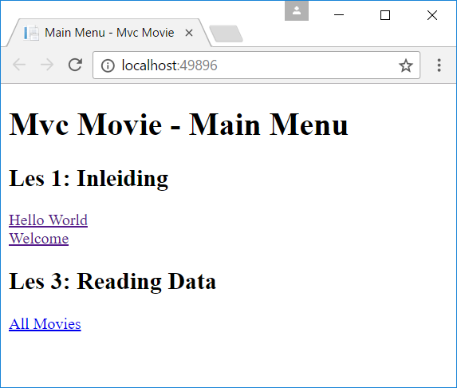
Mvc Movie - Home/Index.cshtml

Slide 4
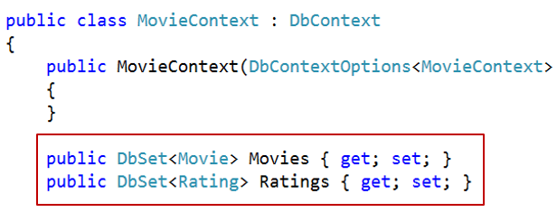
MoviesController.cs
using Microsoft.AspNetCore.Mvc;
using MvcMovie.Data;
namespace MvcMovie.Controllers
{
public class MoviesController : Controller
{
private readonly MovieContext _context;
public MoviesController(MovieContext context)
{
_context = context;
}
public IActionResult List()
{
return View();
}
}
}
Controllers
Add New Item
MoviesController.cs

Slide 5
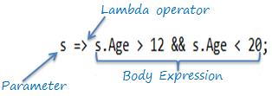
Lambda Expressions
Input_parameter => expression or statement block
=> te lezen als goes to
Lambda expression om via Linq data te lezen uit Movies DBSet in de DBContext
Maar ook: zoeken in lijsten, sorteren van collecties, …

Slide 6
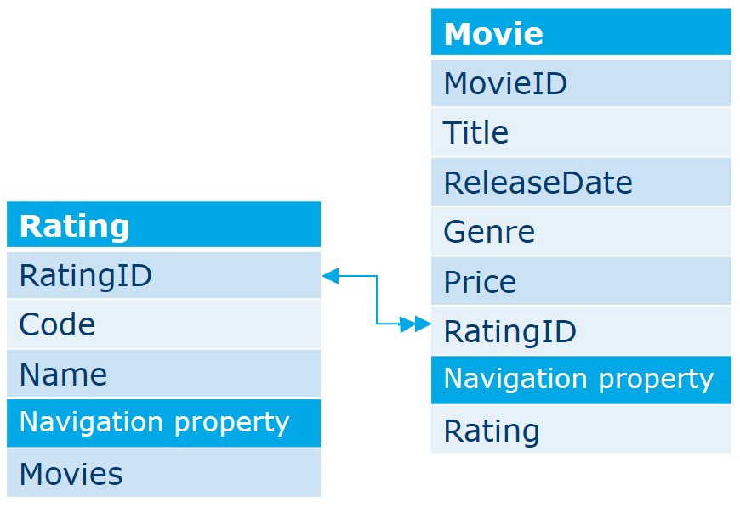
Enkele voorbeelden
var movies =
_context.Movies
.Where(m => m.Genre == "Western" && m.Price < 10)
.OrderBy(m => m.Title);
var movie =
_context.Movies
.Include(m => m.Rating)
.SingleOrDefault(m => m.MovieID == 1);
var firsttitle =
_context.Movies
.Where(m => m.MovieID == 1)
.Select(m => m.Title).Single();

Slide 7
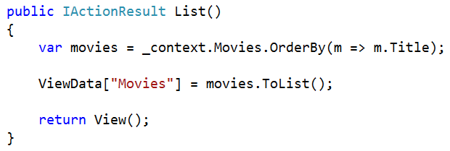
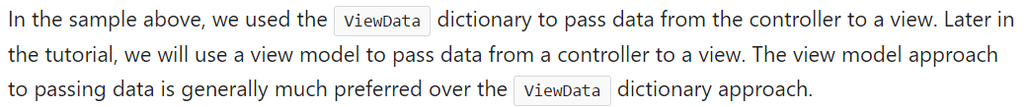
Read all movies (ViewData ⬄ View Model)
public IActionResult List()
{
var movies = _context.Movies.OrderBy(m => m.Title);
return View(movies.ToList());
}

Slide 8
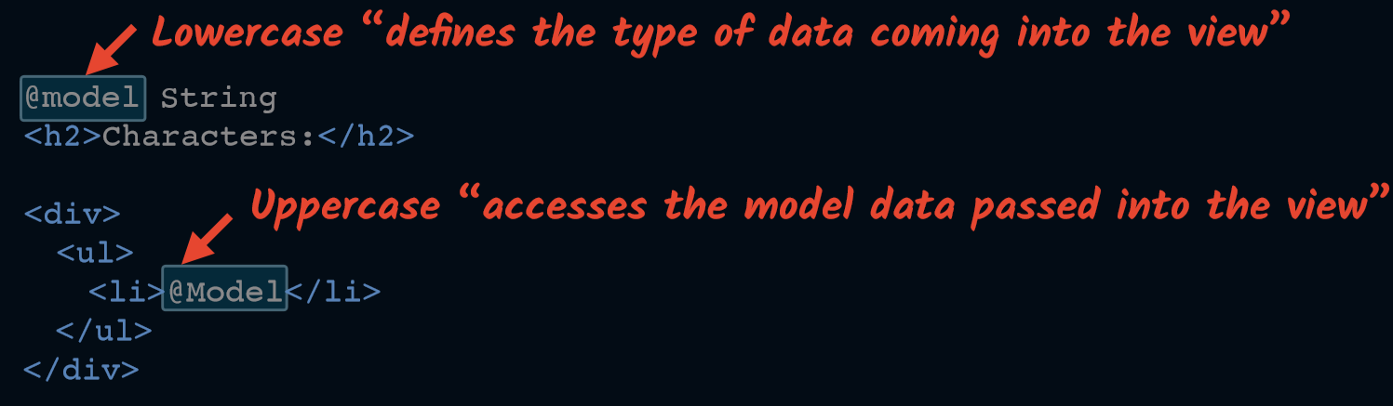
ViewModel

Slide 9
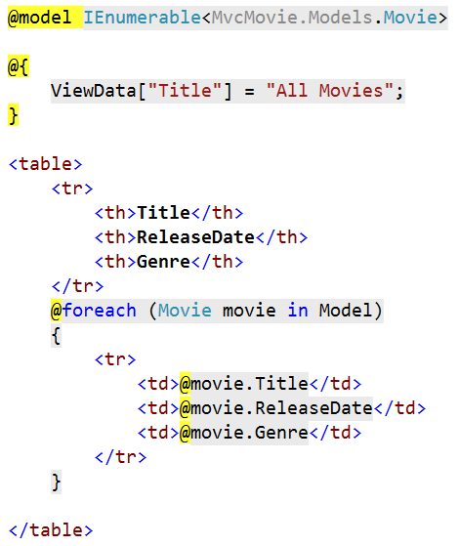
Show All movies (uit resources)
Views | Add Folder | Movies
Movies | Add New Item | List.cshtml

Slide 10
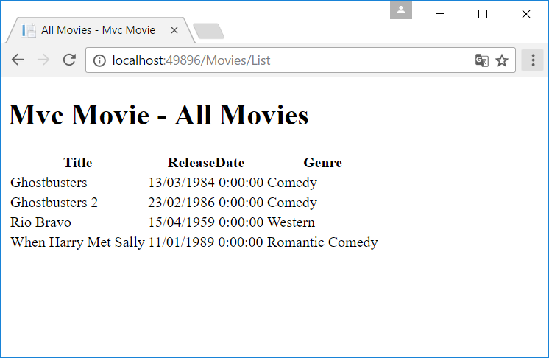
All Movies

Slide 11
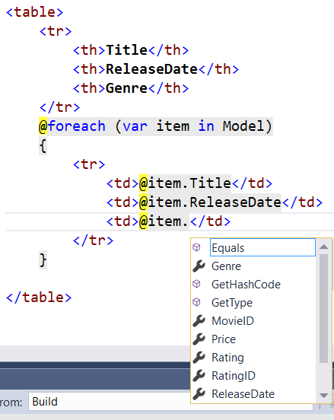
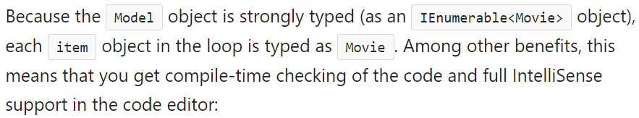
Var keyword

Slide 12
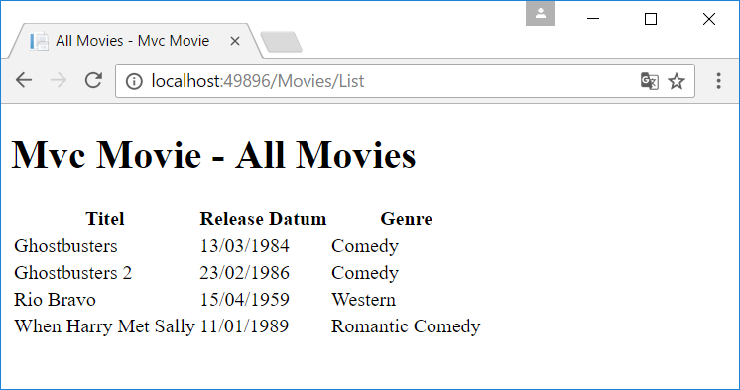
Html Helpers (DisplayFor & DisplayNameFor)

Slide 13
Date Format
Kan in View maar moet dan in elke view telkens herhaald worden
Beter met DataAnnotation en html helper
[DataType(DataType.Date)]
[DisplayFormat(ApplyFormatInEditMode = true,
DataFormatString = "{0:dd/MM/yyyy}")]
public DateTime ReleaseDate { get; set; }

Slide 14
Date Format

Slide 15
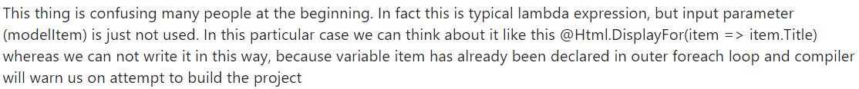
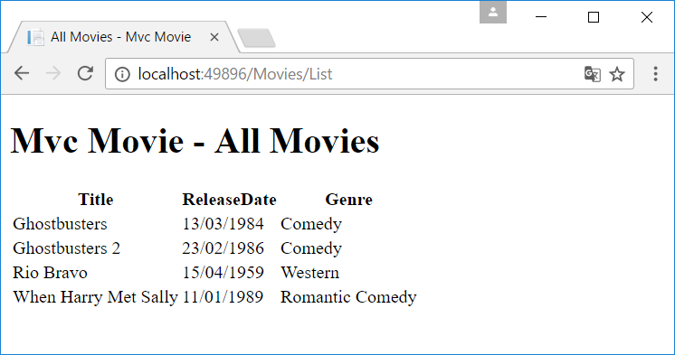
Met html helper
@foreach (var item in Model)
{
<tr>
<td>@(Html.DisplayFor(modelItem => item.Title))</td>
<td>@(Html.DisplayFor(modelItem => item.ReleaseDate))</td>
<td>@(Html.DisplayFor(modelItem => item.Genre))</td>
</tr>
}

Slide 16
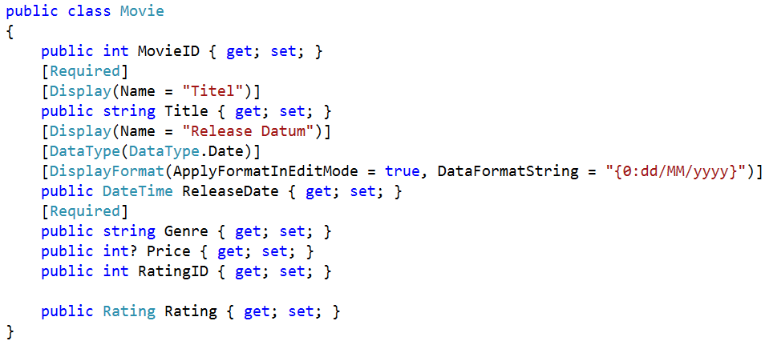
Movie.cs

Slide 17
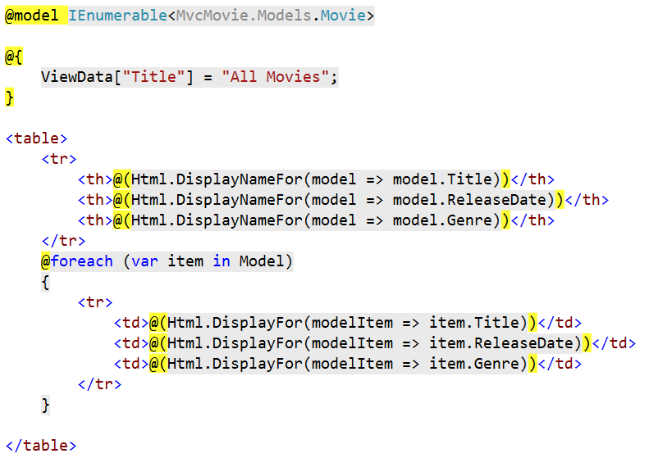
Html Helper voor de hoofding

Slide 18
Movie.cs

Slide 19
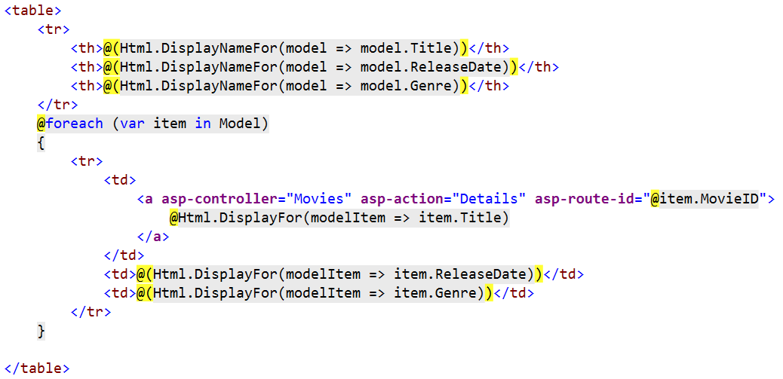
Tag helper

Slide 20
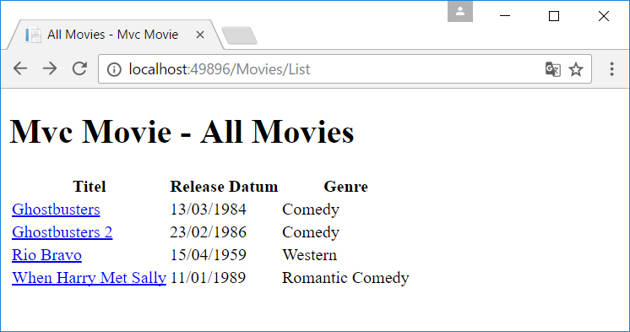
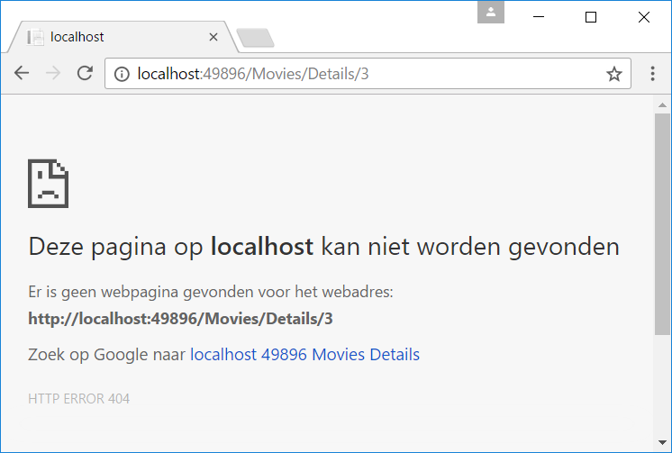
Tag Helper

Slide 21
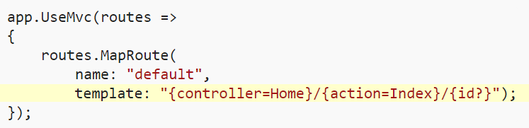
Details
public IActionResult Details(int id)
{
var movie = _context.Movies
.Include(m => m.Rating)
.SingleOrDefault(m => m.MovieID == id);
return View(movie);
}

Slide 22
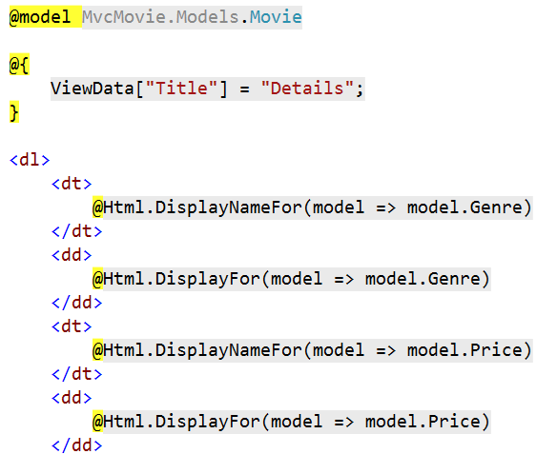
Movies/Details.cshtml (uit resources)
Movies | Add New Item | Details.cshtml

Slide 23
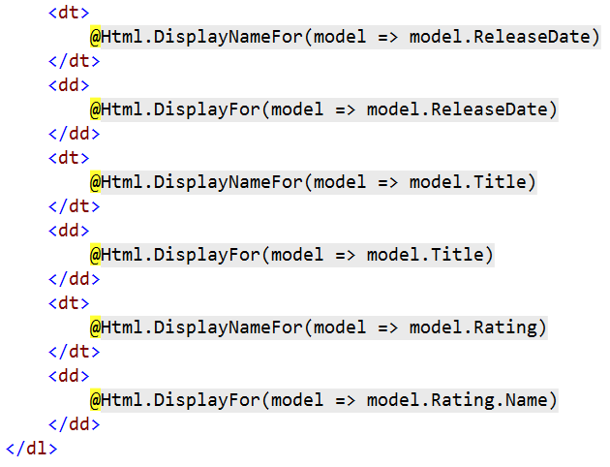
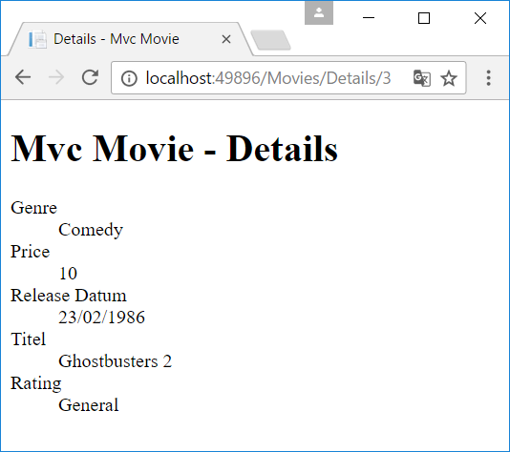
Movies/Details.cshtml

